Slide 1
Project Planning
Group Members: Matt Raporte, Greg Potter
Customer: Professor Huang

Slide 2
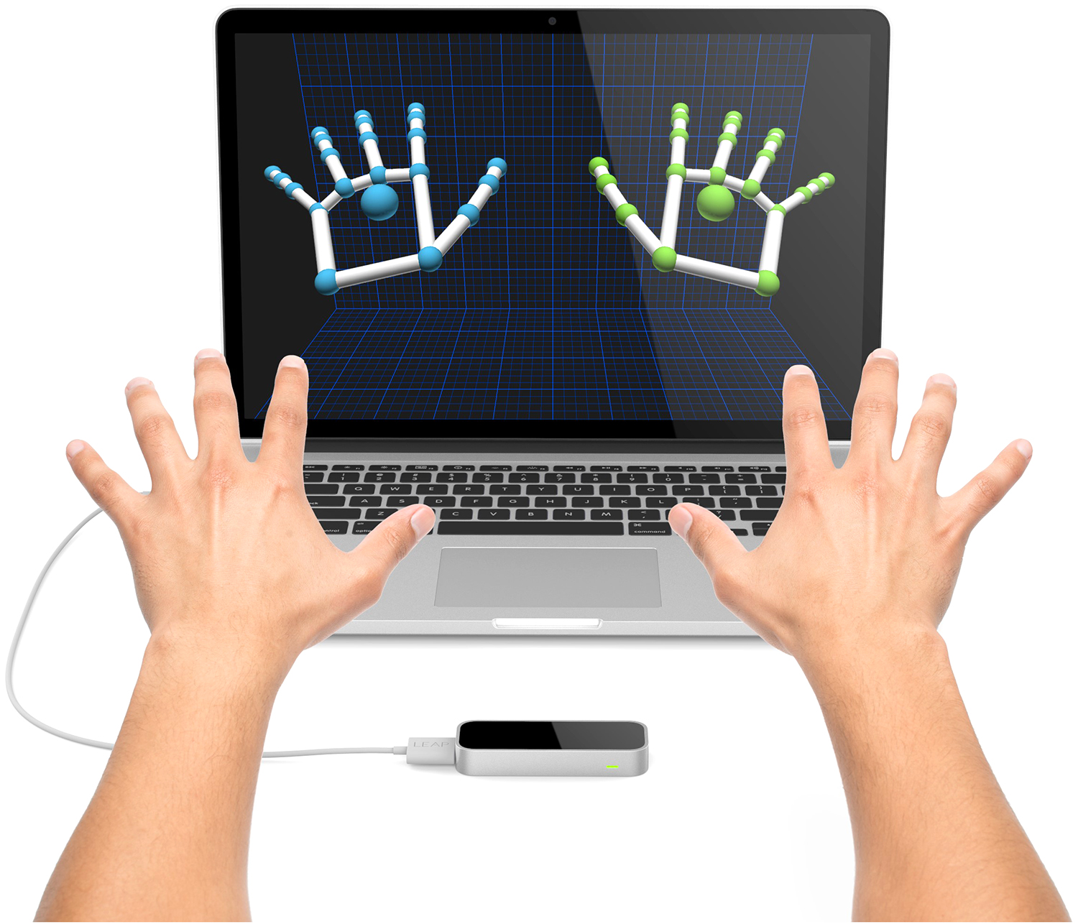
The Project:
1: use Leap Motion controller to detect unique hand gestures using Leap Motion SDK (Java)
2: Map those to actions in Microsoft PP using the PP API and C#

Slide 3
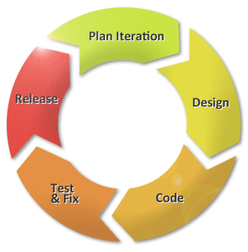
-Progress Reports:
Emailed out to Professor Huang every Sunday.
-Deliverables:
9/29: Project Planning
10/06: Progress Report 3
10/20: Project Design
10/27: Progress Report 4
11/03: Project Implementation
11/10: Progress Report 5
11/17: V&V and Documentation
12/01: Final Posters
-Face-to-face meetings:
Wednesdays at 3PM, Prof. Huang’s office.
Scrum meetings on Sundays to check in on progress/integrate code.
Organization:

Slide 4

Additional goals:
-browse through different directories to select the right PP file to open
-image resizing/movement
-drawing shapes onto screen
Base goals:
-next/previous slides
-skip slides
-press embedded buttons (and play media)
-switch between slide show mode/outline mode

Slide 5
Requirements
Technical:
Development Platform (Linux, Windows, Android,…):
Windows
Development environment / software / languages:
C#, Java, LeapMotion SDK
Performance requirements:
Efficient processor usage to ensure timely command execution, good garbage collection in order not to clog up system with constant Leap Motion input.
Resources required:
Leap Motion Controller
PC/Laptop running Windows
Testing methods:
We will cycle white-box testing during development and extensive black-box testing after we have a working prototype. We will possibly utilize our product for one of our in-class presentations after sufficient testing
Customer Level:
-Easy to setup and use
-Intuitive and easy to remember commands
-Strong gesture detectability, doesn’t “miss” gestures or falsely detect gestures
-Quick detection mapping and command execution
-Robust but useful features

Slide 6
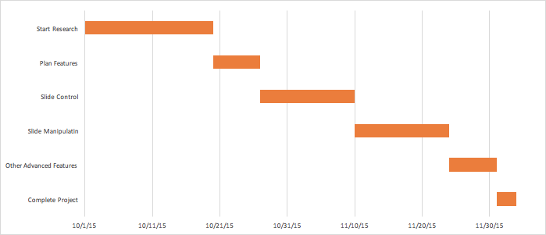
Schedule

